Slide 1
Predicting Positive Returns for the student managed investment fund
Nicole Lind – Data Analytics 401
Github Link: https://github.com/nlind/myDSCI401

Slide 2
The Problem
Which features of a company best predict a positive stock return.
How do we quantify this data?
Does Phillip Fischer’s 15 points really produce positive returns?

Slide 3
Data Collection Phase
Created surveys and collected data from each stock expert
Input the survey responses into excel
Calculated the stock returns using historical data from Yahoo Finance

Slide 4
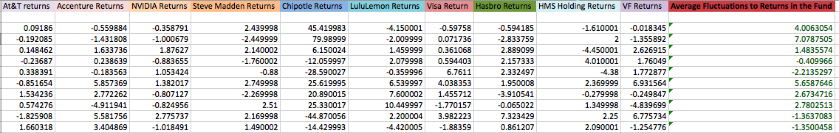
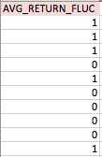

Slide 5
Transformation and Cleaning up Data
Make training set separate from validation set. Check to see if you need an imputer (missing values?)
One-hot encoding
Remove response variable and create “features” variable for all other variables in dataset. Print statement to double check. Set response variable and explanatory variable.
Notes:
use Panda’s get_dummies method, which converts categorical variables into dummy variables and the cat_features method gives you a list of categorical features for the dataframe.

Slide 6
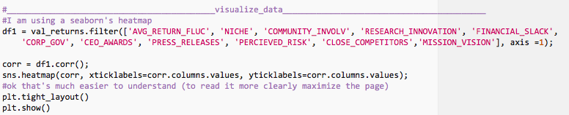

Data Visualization

Slide 7
Evaluating Different models
Support Vector Machine
Decision Tree Model
* Random Forest Classifier *
(With Model Ensemble)
Notes:
Also Performed a lasso regression

Slide 8
Optimizing the Model
Note: Led to Over fitting
Grid Search
Voting Mechanism

Slide 9
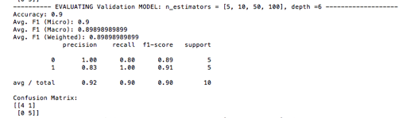
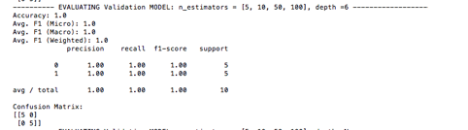
Validation (Without Optimization/With Optimization)

Slide 10
Conclusion:
Garbage in garbage out concept
Predictive validity was very high on random forest classifier
Too many rows, too few columns

